Slide 1


Day 2 - EDA & Data Preprocessing
Building Credit Scoring Model
pacmann.io
© 2022 – Pacmann AI

Slide 2
Outlines
EDA
Data Preprocessing

Slide 3
Modeling Workflow (Simplified)
Data Preparation
Load data
Model Predictions
Create a predictions
Sample selection
Split data to Train, Valid, & Test
Create & Evaluate Model
Create a classification model
Tune the model
EDA
Perform data exploration
Data Preprocessing
Preprocess the data so that can be modeled
Missing value imputation
Remove outliers

Slide 4
EDA (Exploratory Data Analysis)
Notes:
Transisi antar outline

Slide 5
EDA
Objective?
To get insight on what our current data is.
How to?
Get the descriptive stats (tendency/dispersion) & Visualization.
What is the results?
The data distribution (histogram), data count (barplot), etc.
How to handle missing values
How to handle the outliers
Tools?
Pandas & seaborn

Slide 6
EDA
Objective?
To get insight on what our current data is.
How to?
Get the descriptive stats (tendency/dispersion) & Visualization.
What is the results?
The data distribution (histogram), data count (barplot), etc.
How to handle missing values
How to handle the outliers
Tools?
Pandas & seaborn
For data preprocessing

Slide 7
Data Preprocessing
Notes:
Transisi antar outline

Slide 8
Data Preprocessing
Objective
So that data can be modelled
Missing value free
In numeric format → encoding
Outlier free
So that the model performance increases
Standardization
Transformation → binning data, square data, etc.
Resampling

Slide 9
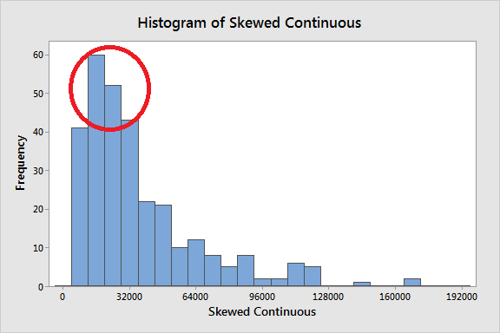
Handling Missing Value
Delete the rows or columns
Impute the missing value with central tendency (not always mean)
image source

Slide 10
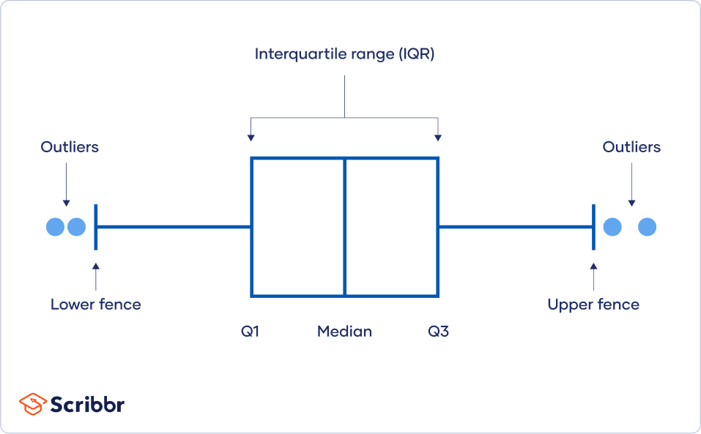
Outlier
You know, math & stats are important in Data Preprocessing.

Slide 11
Outlier
You know, math & stats are important in Data Preprocessing.
A potential outliers!

Slide 12
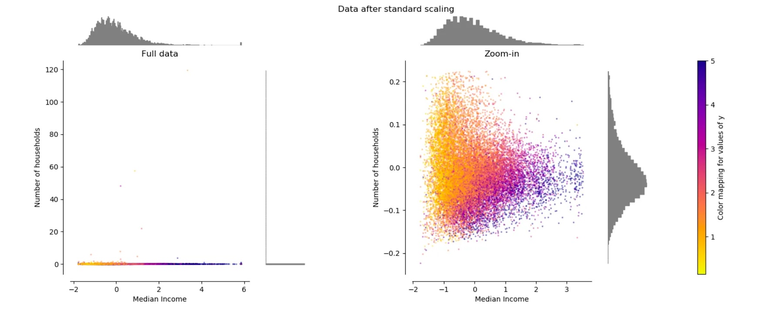
Standardization
Some models need standardize data to perform better
image source

Slide 13
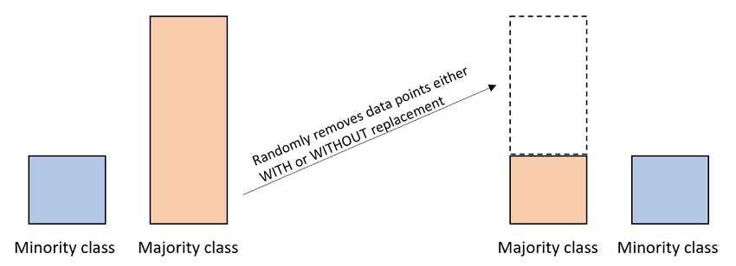
Resampling
Balance your data when learning
image source

Slide 14
Important Note
To prevent data leakage,
Preprocess only on train data
Extract the steps & imputer/scaler/standardizer from preprocessing train data
Preprocess valid/test data using
train set preprocessing steps
train set imputer/scaler/standardrizer

Slide 15
Let’s Code!
Code references: https://github.com/amalinadhi/credit_analytics
Notes:
Transisi antar outline

Slide 16
Thank You
Notes:
Transisi antar outline

